Slide 1
Chapter 11
Project Control

Slide 2
Focus of Control
Scope
Cost
Time
11-<number>

Slide 3
Scope
Technical problems
Technical difficulties
Quality problems
Client wants changes
Interfunctional complications
Technological breakthroughs
Intrateam conflict
Market changes
11-<number>

Slide 4
Cost
Difficulties may need more resources
Scope may increase
Initial bid was too low
Reporting was poor
Budget was inadequate
Correction not on time
Input price changed
11-<number>

Slide 5
Time
Difficulties took longer than planned to solve
Initial estimates were optimistic
Sequencing was incorrect
Unavailable resources
Preceding tasks were incomplete
Change orders
Governmental regulations were altered
11-<number>

Slide 6
Control
“the maintenance of ethical, goal-directed behavior”
Necessary and an inherent part of life in an organization
The PM job is to set controls that will encourage behaviors\results that are desirable and discourage those that are not
People respond to goal-directedness of control systems:
  active and passive participation and goal seeking
  passive participation to avoid loss
  active, but negative participation and resistance
11-<number>

Slide 7
The Fundamental Purposes of Control
The regulation of results through the alteration of activities
The stewardship of organizational assets
11-<number>

Slide 8
Physical Asset Control
Control over the use of physical assets
Includes preventive and corrective maintenance
Must also control inventory
11-<number>

Slide 9
Human Resource Control
Controlling and maintaining the growth of people
People working on projects can gain a wide range of experience
Measurement of human resource conservation is difficult
Performance appraisals and other measures are not satisfactory devices
11-<number>

Slide 10
Financial Resource Control
Current asset control
Project budget
Capital investment control
Techniques same as those applied to general operation of the firm
Context is different because project is accountable to an outsider
Must exercise due diligence over resources owned by the client
11-<number>

Slide 11
Three Types of Control Processes
Cybernetic control
Go/no-go control
Post control
11-<number>

Slide 12
Cybernetic Control
A system that is constantly monitored
When a deviation is spotted, corrective action is taken
Cybernetic controls are not common in projects
Negative feedback loop
11-<number>

Slide 13
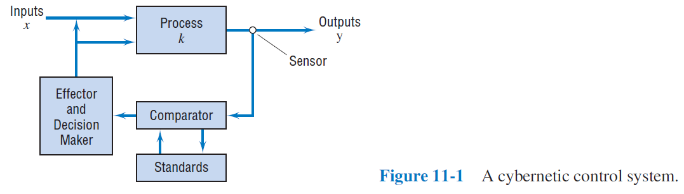
A Cybernetic Control System
11-<number>

Slide 14
Information Requirements for Cybernetic Controllers
Must have a counteraction for every action
Not possible for complex systems
  Must define what characteristics of an output to control
  Standards must be set
  Sensors must be acquired
  Measurements must be compared to a standard
  Difference sent to the decision maker
11-<number>

Slide 15
Go/No-go Controls (Slide 1 of 2)
Testing to see if some preset condition has been met
Most of project management is go/no-go controls
Use cannot be based on the calendar
  Some will take place at milestones
  Some will take place when work packages are completed
  Others will be on-going
11-<number>

Slide 16
Go/No-go Controls (Slide 2 of 2)
Data to be collected will match the critical elements of the project plan
Actual is compared to what was expected in the plan
Regular reports are given to the project manager and senior management
11-<number>

Slide 17
Phase-Gated Processes
Controls the project at various points throughout its life cycle
Most commonly used for new product/service development projects
Project must pass gate to continue funding
11-<number>

Slide 18
Postcontrol
These are controls that are applied after the fact
Their purpose is to mainly improve the performance on future projects
Often times, a final report is prepared comparing the plan with reality
Sometimes called “lessons learned”
Can be thought of as a report card
11-<number>

Slide 19
Postcontrol Report Sections
The project objectives
Milestones, gates, and budgets
The final report on project results
Recommendations for performance and process improvement
11-<number>

Slide 20
The Design of Control Systems
Who sets the standards?
Are the standards realistic?
Are the standards clear?
Will they achieve the project goals?
What should be monitored?
How should they be monitored?
Many more…
11-<number>

Slide 21
Characteristics of a Good Control System
Flexible
Cost effective
Useful
Ethical
Timely
Accurate
Simple
Easy to maintain
Fully documented
11-<number>

Slide 22
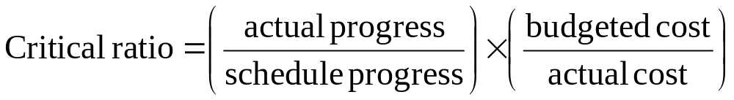
Critical Ratio Control Charts (Slide 1 of 3)
Made up of two parts:
  Ratio of actual progress to scheduled progress
  Ratio of budgeted cost to actual cost
Caeteris paribus
11-<number>

Slide 23
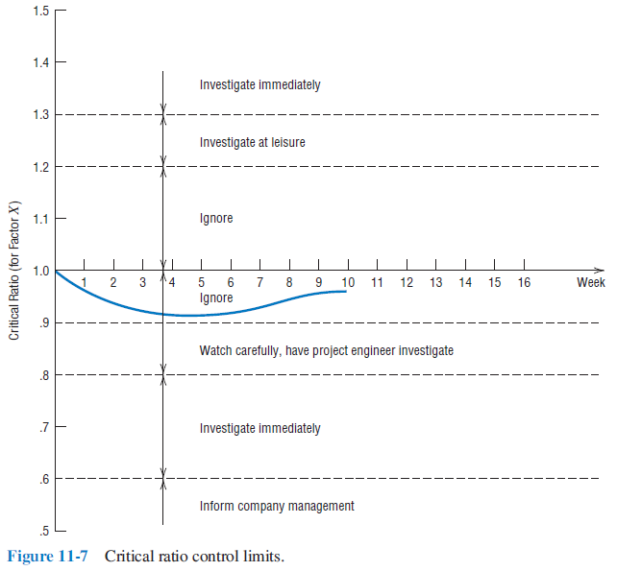
Critical Ratio Control Charts (Slide 2 of 3)
11-<number>

Slide 24
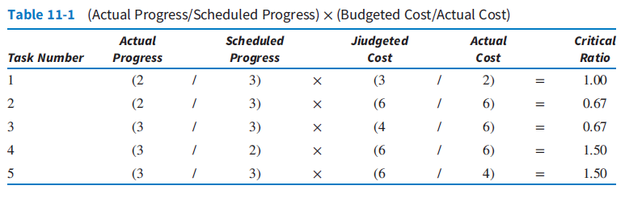
Critical Ratio Control Charts (Slide 3 of 3)
11-<number>

Slide 25
Benchmarking
making comparisons to “best in class” practices across organizations
11-<number>

Slide 26
Benchmarking Best Practices
Promoting the benefits of project management
Personnel
Methodology
Results of project management
On-course improvement in project management practices
11-<number>

Slide 27
Control of Change and Scope Creep
Uncertainty about the technology
Increase in the knowledge base or sophistication
Modification of the rules applying to the project
Coping with changes is perceived as the most important problem facing project managers
11-<number>

Slide 28
Purpose of Formal Change Control System (Slide 1 of 2)
Review all changes
Identify all task impacts
Translate impacts into scope, cost, and schedule
Evaluate the benefits and costs
11-<number>

Slide 29
Purpose of Formal Change Control System (Slide 2 of 2)
Identify alternative changes
Accept or reject
Communicate
Ensure implementation
Report
11-<number>

Slide 30
Guidelines for an Effective Change Control Procedure
Include change process in all agreements
Issue a change order for all approved changes
Project manager must be consulted
Changes must be approved in writing
Master plan must be amended
11-<number>

Slide 31
Controlling Creative Activities
Creativity is hard to control
Too much control will stifle creativity
Three general approaches
  Process Review
  Personnel Reassignment
  Control of Input Resources
11-<number>

Slide 32
Copyright
Copyright © 2018 John Wiley & Sons, Inc.
All rights reserved. Reproduction or translation of this work beyond that permitted in Section 117 of the 1976 United States Act without the express written permission of the copyright owner is unlawful. Request for further information should be addressed to the Permissions Department, John Wiley & Sons, Inc. The purchaser may make back-up copies for his/her own use only and not for distribution or resale. The Publisher assumes no responsibility for errors, omissions, or damages, caused by the use of these programs or from the use of the information contained herein.
Copyright ©2018 John Wiley & Son, Inc.

